Slide 1
Power Board V3.5 Connector Details

Slide 2
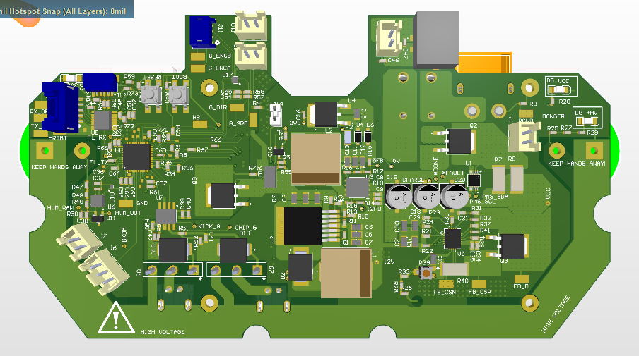
Top Side
Motordriver 10 pin Connector (Bottom Side)
Jetson Nano Barrel Plug Power Connector
Geneva Encoder Connector
Geneva End Stop Connectors
FTDI (USB) Connector
Battery Connector (Bottom Side)
UI Board Connector
Power Switch Connector
Breakbeam connectors
Kick Connector (Bottom Side)
Chip Connector (Bottom Side)

Slide 3
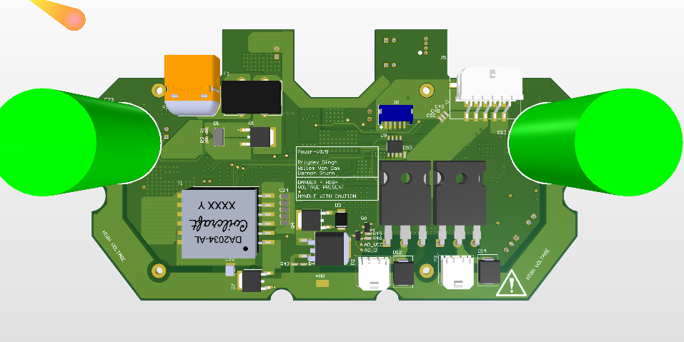
Bottom Side
Geneva Motordriver Connector
Battery Connector
Motordriver 10 pin Connector (Bottom Side)
Chip Connector
Kick Connector

